Slide 1


ANALYZING TRENDS AND CHARACTERISTICS OF VEHICLE RECALLS
Course: Advanced Topics in Machine Learning
Lecturer: Chen Hajaj
Team Members: Lilya Shvedskaya & Lior Vanounou
Github link: https://github.com/LilyaShv/Vehicles_Project.git

Slide 2





THE PROBLEM: ANALYZING AND CLASSIFYING VEHICLE DATA FOR INFORMED DECISION MAKING
The main challenge of this project is vehicle data prediction and classification using machine learning techniques such as classification and clustering. Our goal is to understand the characteristics of vehicles and focus on identifying vehicles with specific attributes that can serve as a basis for decision-making in the automotive industry.

Slide 3


PROJECT OBJECTIVES
Investigate the relationships between various characteristics of vehicles, such as age, weight, engine volume, and their potential impact on their removal from service.
Explore anomalies or unusual events in vehicle data, contributing to a deeper understanding of underlying patterns and their potential real-world implications in the automotive industry.
Classify vehicles based on their attributes to assist in decision-making processes, such as identifying high-risk vehicles or those in need of regulatory attention.
Apply clustering techniques to discover hidden patterns in the dataset and group vehicles with similar characteristics for targeted business or regulatory strategies.

Slide 4


METHODS AND TECHNIQUES
In addition to the classic classification and clustering methods (Random Forest, Gradient Boosting, KMeans), we applied Dimensionality Reduction techniques (such as PCA and Kernel PCA) to help analyze data in a clearer way. Additionally, we explored the DBSCAN method for evaluating clustering quality.

Slide 5
DATASET AND FEATURES
The data was obtained from the official public dataset provided by the Israeli government(info.gov.il). It contains information about vehicles imported to Israel, with each row representing an individually imported vehicle.
Key features selected:
tozeret_nm (Manufacturer Name)
sug_rechev_nm_reduced (Vehicle Type)
mishkal_kolel (Total Weight)
shnat_yitzur (Manufacture Year)
nefach_manoa (Engine Capacity)
tozeret_eretz_nm (Country of Manufacture)
tokef_dt_year (Year of License Expiration)
tokef_dt_month (Month of License Expiration)

Slide 6

METHODOLOGY
Initially, we used PCA for dimensionality reduction to uncover hidden patterns. Later, we transitioned to Kernel PCA due to the need for capturing non-linear relationships.
The classification techniques chosen were:
Random Forest
Gradient Boosting
SVM
KNN
For clustering, we experimented with KMeans and DBSCAN, both offering unique insights into the data's structure.

Slide 7

EXPERIMENT OVERVIEW AND EVALUATION TECHNIQUES
PCA vs. Kernel PCA: We initially used PCA, but the silhouette score was low (0.073). After switching to Kernel PCA, the result improved significantly (0.76).
Clustering: We started with KMeans (K=4), then switched to DBSCAN, which yielded better results (Silhouette Score: 0.71).
Model Evaluation: All models (Random Forest, Gradient Boosting, SVM, KNN, Neural Network) were evaluated using accuracy and classification_report metrics.

Slide 8
RESULTS AND EVALUATION
Classification Models (Accuracy Scores)
Random Forest (0.409): Performed reasonably well, capturing some patterns in the data, though not optimal for all vehicle attributes.
Gradient Boosting (0.008): Struggled significantly, likely due to noise or outliers in the dataset.
Neural Network (0.332): Performed below expectations, possibly due to dataset complexity or insufficient data size.
SVM (0.049): Showed poor performance, suggesting it was unsuitable for this dataset's complexity.
KNN (0.242): Also underperformed, likely due to sensitivity to irrelevant features or noise.
Clustering Results
KMeans (Silhouette Score: 0.41): Produced some meaningful clusters but with ambiguous boundaries, indicating room for improvement.
DBSCAN (Silhouette Score: 0.71): Provided clearer and well-defined clusters, effectively handling noise and identifying outliers.
Visualizations
KMeans: Clusters were identified but with unclear boundaries.
DBSCAN: Presented well-defined clusters and effectively highlighted noise points as outliers.
Summary
Random Forest was the most successful model, while DBSCAN outperformed KMeans in clustering, showing clearer results and better handling of outliers. The overall performance suggests room for improvement through further data preprocessing and model tuning.

Slide 9
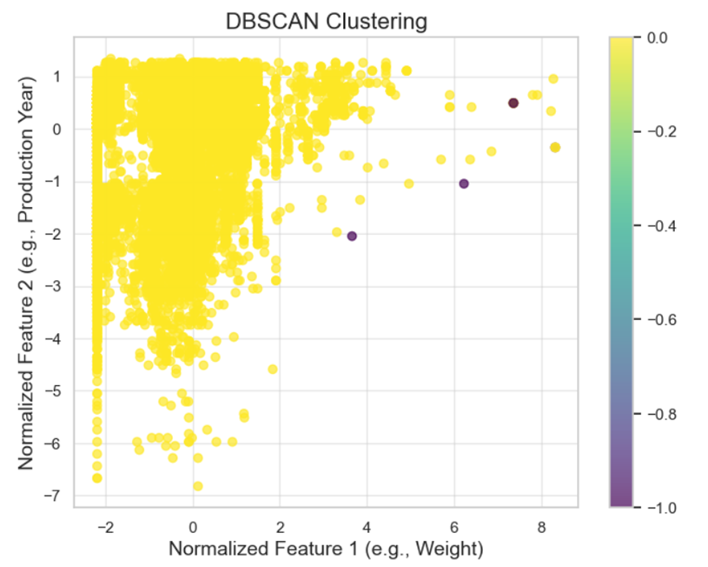
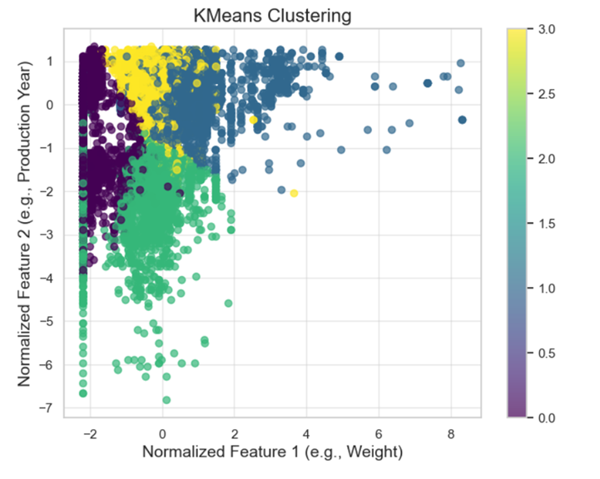

Slide 10


COMPARISON OF THE APPLIED TECHNIQUES
SVM and KNN struggled with the complexity of the features, especially due to the high dimensionality and uneven distribution of the data.
Random Forest and Gradient Boosting were the most successful for predicting vehicle attributes, showing higher accuracy compared to other models.
DBSCAN proved to be the best model for clustering, with a Silhouette Score of 0.71.

Slide 11
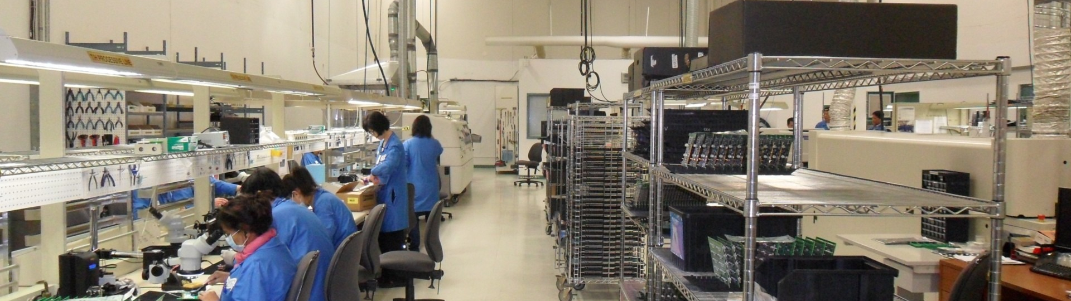

CONCLUSION
Classification: The models Random Forest and Gradient Boosting were the most successful in predicting vehicle attributes. These models effectively handled mixed data types and demonstrated good accuracy for tasks such as vehicle assessment and regulatory predictions.
Clustering: KMeans generated meaningful clusters but struggled with varying densities. In contrast, DBSCAN provided clearer, more defined results with a higher Silhouette score (0.71), making it the preferred method for identifying irregular clusters and outliers.
Future Insights:
Anomaly Detection: The results can help identify abnormal vehicles with unusual characteristics, contributing to fraud prevention and compliance enforcement.
Regulatory Predictions: Predicting key vehicle attributes like registration expiration can improve the efficiency of regulatory processes.
Business Decision-Making: These insights can assist businesses in optimizing inventory, marketing, and services based on vehicle characteristics and predicted trends
In summary, Random Forest and Gradient Boosting are highly effective for predicting vehicle attributes, while DBSCAN excels in clustering and anomaly detection. These insights are valuable for improving regulatory processes, detecting anomalies, and supporting data-driven business decisions in the automotive industry.

